Slide 1
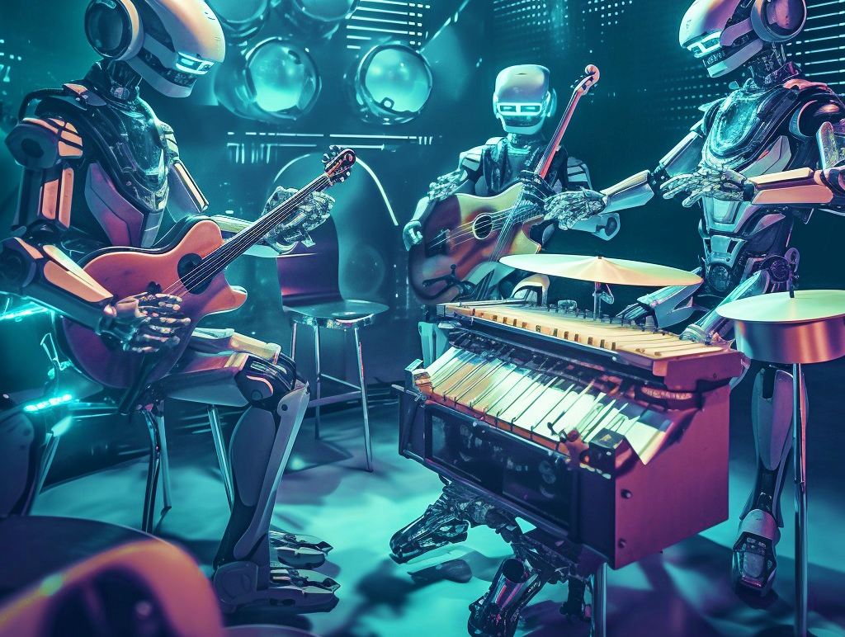

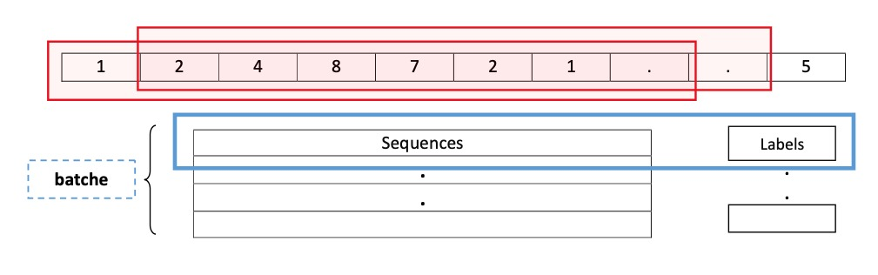
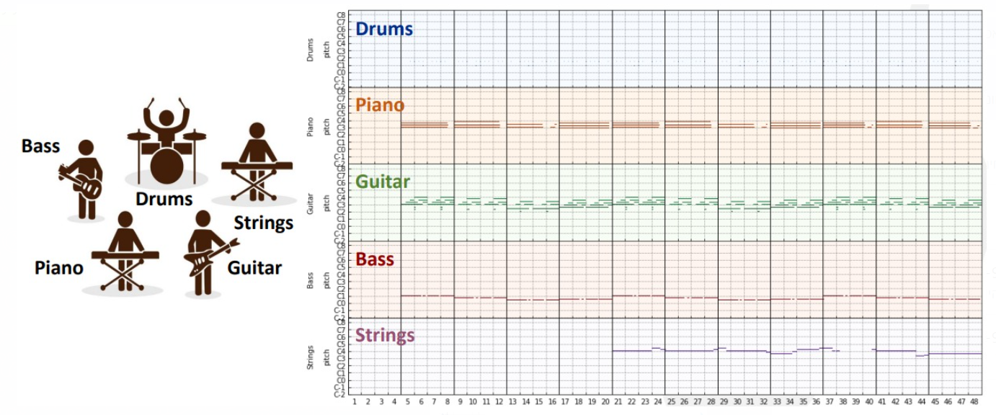
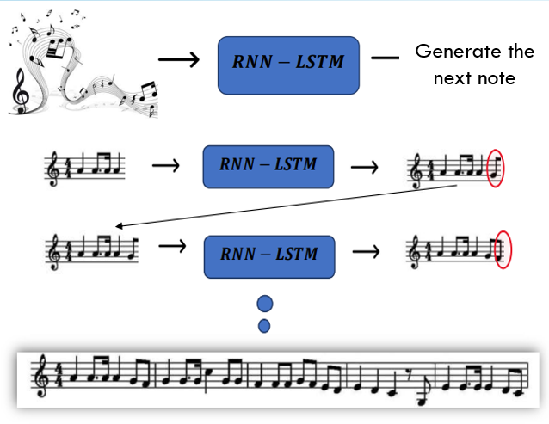
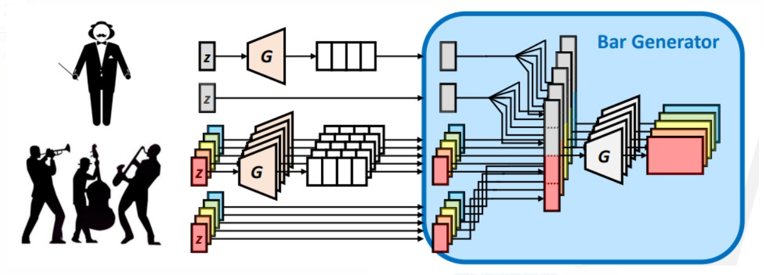
Generating Melodies
From Algorithms to Masterpieces:
Can Machines Become the Next Mozart?
GAN Model
RNN – LSTM Model
Generative Adversarial Networks
Recurrent Neural Networks (RNNs) process sequential data.
Pre-processing:
We used a MIDI dataset of pop songs with varying lengths and diverse instruments. First instruments were categorized into Drums, Piano, Guitar, Bass, and Strings, where similar instruments like electric and acoustic guitar were combined into one category. Additionally, all music pieces were divided into
fixed-size 4-bar phrases.
Training:
Our model learns to create new music by taking random noise vectors and generating fixed-size music pieces using the generator. It uses the real music pieces as a reference. The model shuffles the real and newly created pieces and feeds them to the discriminator, which tries to distinguish between real and fake music.
Generation:
Our model's success is measured by the number of fake music pieces labeled as real by the discriminator. By iterating this competitive learning process, the generator becomes increasingly skilled at producing realistic music compositions, providing a unique and creative output.
Pre-processing:
We utilized the "Esac" MIDI database, filtering out songs with rare notes. MIDIs were converted to text representations with unique symbols assigned to each note. Sequences of N notes were paired with the N+1 note as their label.
Training:
The training process consisted of multiple epochs where data was converted to one-hot vectors. The model's performance
was assessed using cross-entropy loss and evaluated with the evaluation data after each epoch.
Generation:
The model generates music by starting with a sequence of N notes and predicting the N+1 note. The predicted note is added to the sequence, and the process continues until the model predicts the ending note symbol, indicating the completion of the generated music.
Tal Rozenzwieg | Shani Ofir | Lior Sherman

